Slide 1
Music of India
Global Studies

Slide 2
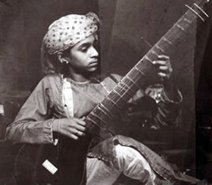
Ravi Shankar
Performer, Composer, Teacher
His consistent mission? To demystify Indian music for an international public audience.
Biographical Highlights
Born in 1920 in Varanasi (aka Benares), India
Born into the Brahmin (highest) caste
Age 10: traveled with his brother’s dance troupe to Europe (based in Paris – resided there until 1938). This experience gave Shankar both a deep understanding of Indian music as well as in-depth knowledge of Western music.

Slide 3
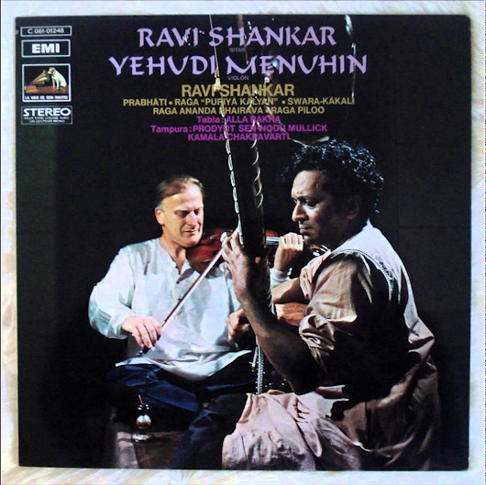
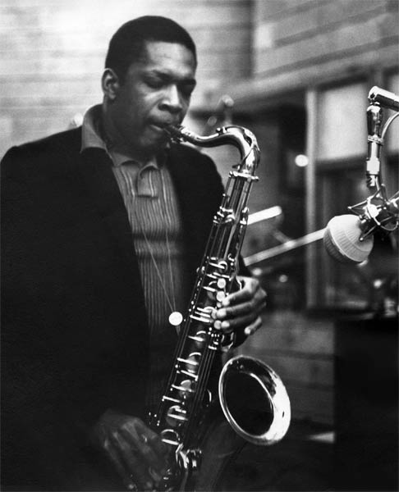
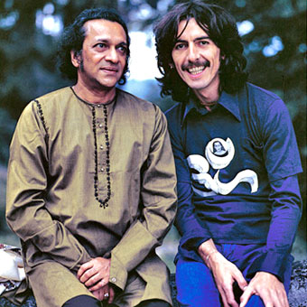
Biographical Highlights (continued)
1938: began serious study of sitar under Allaudin Khan. Within a year, Shankar was performing public recitals.
1946: became director of All-India Radio, composed works for sitar and other Indian instruments with classical Western instrumentation
1950s-1980s:
began collaborating with American violinist Yehudi Menuhin, performing and composing.
This led to the first significant cross-cultural albums: West Meets East (1967 – Grammy award-winning); West Meets East, Vol. 2 (1968)
Influenced American jazz icon John Coltrane; met in 1964, planned to work together but Coltrane died in 1967
1966: met George Harrison of The Beatles. This led to a long and productive partnership. Shankar’s relationship with Harrison raised Shankar’s international profile, particularly with fans of pop music.

Slide 4
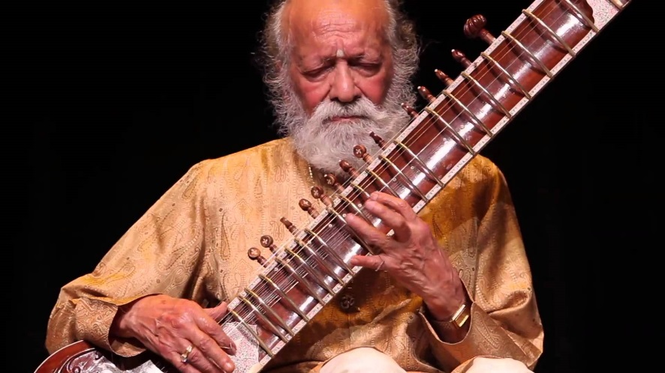
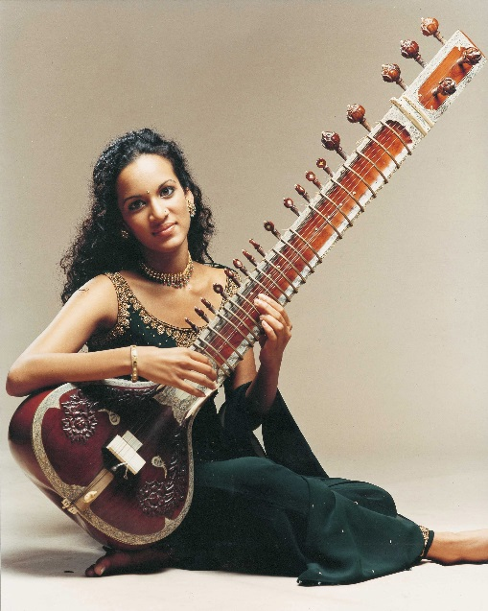
Biographical Highlights (continued)
1950s-1980s (continued)
Performed at Monterey (CA) Pop Festival and at Woodstock
“Concert for Bangladesh” in 1971 – considered the first modern charity concert.
Worked at several American universities
Multiple tours throughout world – furthering Shankar’s goal of educating people about Indian music
Throughout this time, Shankar composed: classical Indian, Indian dance dramas, film scores (nominated for Oscar in 1982), collaborative works fusing Indian and Western traditions, use of electronic instrumentation
Musical daughters
Norah Jones (b. 1979) – American singer/songwriter
Anoushka Shankar (b. 1981) – Indian sitar player and composer
Ravi Shankar passed away in December 2012

Slide 5
Indian Music in Context
bhajan (BUH-jin): Hindu devotional songs and hymns
Baqawathar: musician extended meaning? he who sings the praises of God
In Praise of Krishna – example of a bhajan
Section | Brief description | Expanded Description
0:00—0:09 | Solo voice with instrumental accompaniment
0:10—0:20 | Vocal group
0:20--0:25 | Abbreviated repeat of 0:10-0:20
0:26—1:11 | Solo voice with instrumental accompaniment; extended range and use of more elaborate ornamentation
1:12—end | Group—fades out
Relatively simple melody, ornamented, drone instrument, bell percussion
Echo
Range is expanded, but not huge. Drum percussion added

Slide 6
Sufism: mystical form of Islam – music serves as a pathway to the divine
Ishq – Sufi song that is an example of qawwali music; features driving drum rhythms and singing. From the Punjab region
Melismatic singing: many pitches per syllable
Section | Brief description | Expanded Description
0:00—0:06 | Instrumental intro; unmetered
0:06--0:30 | Solo voice over instruments; unmetered; similar to?
0:31—0:46 | Instruments begin metered performance
0:46—end | Solo voice; improvisational and highly ornamented
Drone starts, establishes tonal center
Drone background, melismatic singing
Accordion solo, mrdangam
Percussion has improvised fills

Slide 7
The Gharana
What is a gharana?
musical family – knowledge of raga is disseminated and legacies of performances passed musician to musician, generation to generation
What unifies members of a gharana?
shared style or approach to performance practice
To whom does the founder of a gharana trace his lineage?
16th century musician Tansen (believed to have received his gifts from the divine)
How does a gharana evolve?
process of growth through each generation’s collective efforts and devotion

Slide 8
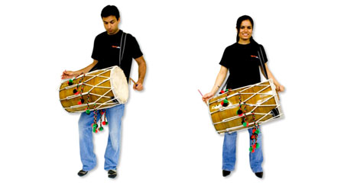
Musical Diversity
There is great diversity in Indian music including thousands of genres, subgenres, and styles of folk, religious, devotional, popular, and film music.
Bhangra, for example, features lively Punjabi folk songs and dances accompanied by powerful rhythms played on a large, barrel-shaped drum called a dhol
Bhangra is featured in the soundtracks of numerous Bollywood movies.
Kudi, Kudi by Jasbir Jassi.

Slide 9
Filmi git: Indian film songs
Jai Ho
O Saya
What is “Bollywood”?
Film industry based in Mumbai
What is Nada Brahma?
Sound of God – singing is regarded as the highest form of musical expression

Slide 10
Two Great Traditions:
Comparison of Karnatak and Hindustani Music Traditions
Similarities | Differences
Raga basis of melody
Tala basis for rhythm & meter
Part of larger sangita tradition (music, dance, drama
Part of larger concept of performance arts
Singing – highest form of expression
Instrumental traditions parallel vocal tradition
Related histories (especially pre-1500s)
Related instrument types
Distinct styles since 1500s
Hindustani: greater Islamic influence (esp. Mughal)
Karnatak: less Islamic influence
H: more international exposure & recognition outside of India
K: Status of singing is more elevated relative to instrumental
Specific ragas, talas and music termino-logies are different in the two traditions
This chapter focuses mostly upon the Hindustani tradition. Here is the single Karnatak example provided: Sarasamadana

Slide 11
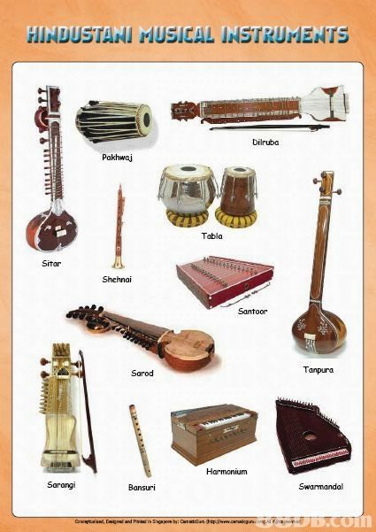
Typical Instruments
Most Common:
Melodic
Drone
Percussion

Slide 12
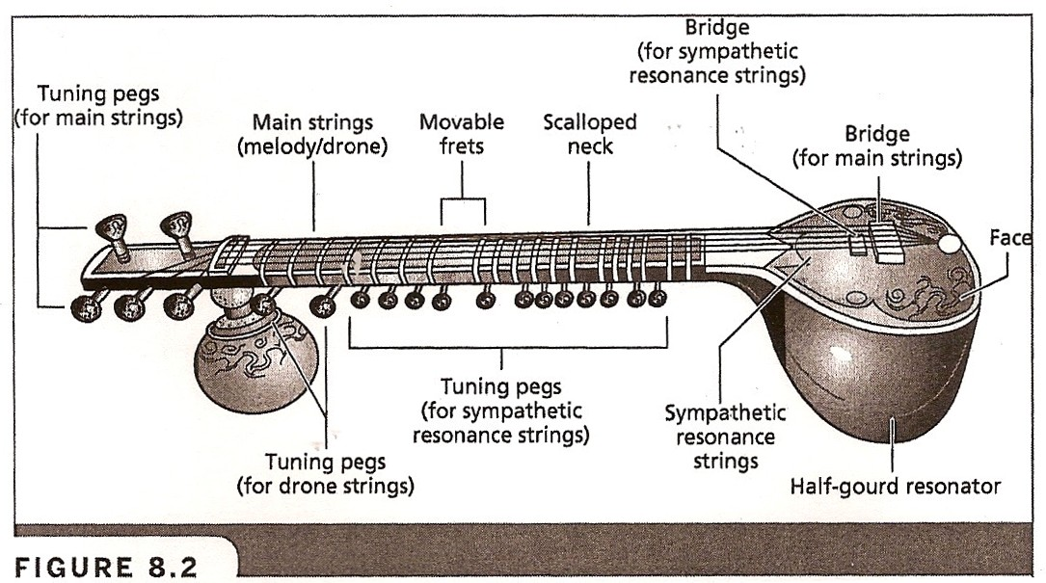

Slide 13
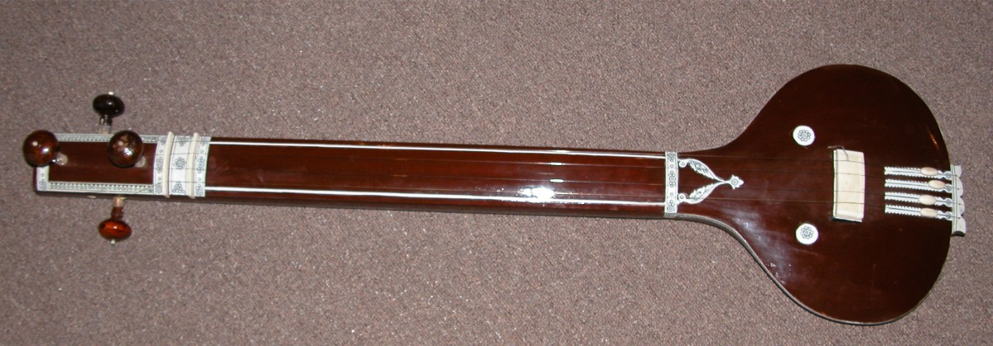
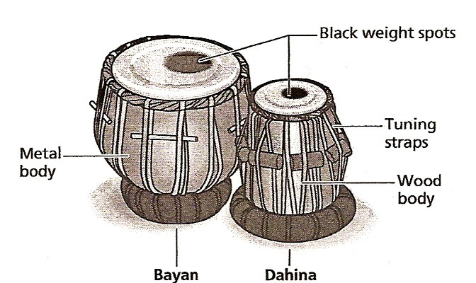
Tambura
Tabla

Slide 14
“An Introduction to Indian Music”
The heart of this chapter’s exploration of Indian music and the key to understanding the instruments, elements, genres, and forms of the music of this ancient musical culture is the recorded lecture demonstration “An Introduction to Indian Music,” by Ravi Shankar. Turn to page 128 and follow the recording.

Slide 15
Raga Defined
Features | Description
An identifying set of pitches
A unique repertoire of melodic ornaments and melodic motives
A set of rules and procedures
A repertoire of set compositions
A host of extramusical associations
scale; usually 7 ascending and 7 descending. Not always same pitches, also different shapes of melodic contour. Pitches drawn from a tonal system with at least 22 distinct pitches per octave
Ornamentation: “decorating” the main pitches, thus making a melody more complex
Motive: a short musical idea; a fragment of a melody
These are accomplished using microtonal inflections: notes between notes (pitches located between the raga’s main pitches)
How to deal with various pitches, ornaments, melodic motives – musical road map guiding improvisation. Internalized in musician’s mind after years of study and practice
oral/aural tradition, both old and new. Same system of rules and regs that guides improvisation is also embedded within each composition
time of day, season, ceremonial event, emotional state of mind
Ie., “morning raga”, “summer raga”, raga expressing joy, sorrow, peace

Slide 16
Tala Defined The tala provides the rhythmic framework of a raga performance and the metric cycle within which the music is grounded.
Feature | Description
Specific number of beats
Specific pattern of stronger and weaker beats
Theka
Sam
Can range between 3 to over 100 beats per cycle. Two popular talas are tintal (16 beats) and jhaptal (10 beats)
Also known as meter
skeletal drumming pattern
it is rarely heard unembellished, except when the tabla initially enters. After this, there is significant improvisation and ornamentation
first beat of each tala cycle
(simultaneously serves as the last beat of the preceding cycle)

Slide 17
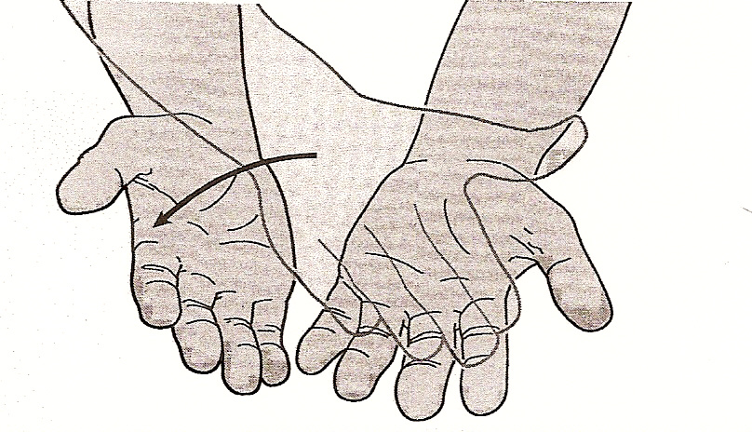
Keeping Tal
Beats 1, 5, and 13 are marked by a handclap. These are the tali, or “full” beats, of this metric cycle. Beat one receives the most emphasis, since it marks the important principal beat sam.
Beat 9 (khali, meaning “empty”) is marked by a silent wave. See Figure 8.5 on page 136 or the image reproduced below.

Slide 18
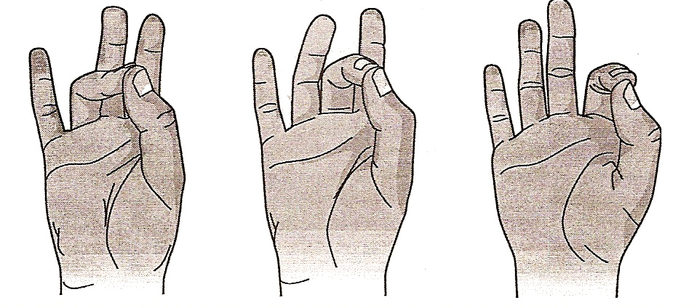
All of the remaining beats in tintal are marked by finger touches, in which you touch your right thumb with the tips of your right ring, middle, and index fingers, one after the other, on successive beats (see figure 8.6 on page 137 or the image reproduced below). These are the subordinate beats of the cycle.

Slide 19
Form in Raga Performance
Alap
Gat
Slow, abstract
Fast, metered
Progressive introduction of raga’s tones, stylistic elements
Gradual expansion of melodic range; suggestion of rhythm pulse toward end
Improvised
Arrival of drumming and establishment of the tala announces gat
Progressive intensification through overall increase in tempo, complexity of cycles
Growth of musical interaction between performers
Alternation of composed and improvised section
Performance builds to a climactic finish
Tihai: the repetition of a rhythmic pattern three times to mark the conclusion of a raga

Slide 20
Raga Nat Bhairav, Vishwa Mohan Bhatt
Bhatt is one of Ravi Shankar’s best-known disciples. He is a member of the Maihar Gharana, which was founded by Shankar’s mentor, Allaudin Khan. He won a Grammy for Best World Music Album in 1993 (A Meeting by the River with Ry Cooder). He uses a modified Western guitar (3 melody strings, 4 drone strings, 12 sympathetic resonance strings) and plays it in a slide guitar style.
Section | Comments/Observations
Alap 0:00—0:47
0:48—1:14
1:15—2:58
2:59—3:08
Drone introduced; sequence of 4 guitar notes – D (high), D (low), A, and D (high, again)
Opening section of alap melodic development from 0:06; descent through 1 octave of the raga “scale”, with each main pitch explored
Ascent back up through the octave to the starting pitch, with exploration of the ascending form of the raga
Bhatt continues to develop the raga in more elevated octave territory. Energy intensifies and rhythm becomes more active. At 2:46-2:58, there is a dramatic run up and down the raga scale
Steady rhythmic pulse emerges, bringing alap to conclusion and commencing the gat

Slide 21
Section | Comments/Observations
Gat 3:09—end
Tihai 7:00—end
Entrance of tabla announces the start of the gat section
Tintal is the tala (metrical cycle) used here
Raga grows throughout the gat; music moves through series of set compositions and improvised sections
Shorter passages give way to longer patterns and segments; complexity deepens
Interaction between musicians grows as well: guitar leads (3:49-4:05); different lines simultaneously (3:19-3:29, 5:11-5:36); tabla leads (5:36-5:43); tight unison (6:50-7:10)
Climactic ending with unison rhythmic passage

Slide 22
John Coltrane
Ravi Shankar resisted the notion that somehow jazz and raga were closely related but he did note that there are some similarities – emphasis on virtuosity and improvised solos
Shankar also pointed out that in his experience jazz musicians were “quick to grasp the rhythmic subtleties of Indian music, in ways that (Western) pop and classical musicians were not.”
John Coltrane spent time listening to and studying Indian music, especially Shankar’s work, in advance of recording India in 1961.
Coltrane did study with Shankar briefly in the winter of 1964-65, but they were never able to record together before Coltrane’s death in 1967.
Section | Comments/Observations
0:00 – 0:07
0:08 – 0:24
0:25 – 0:44
0:45 – 0:54
0:54 – 1:22
1:23 – 1:42
1:43 – 1:57
1:58 – end
rhythm section opens; drone-like sameness throughout
melodic fragment
improvised passage, “sheets of sound”
melodic fragment; rhythm section
soprano sax & clarinet duet
improvised melody
sax/clarinet duet; saxophone adds ornaments
improvised melody

Slide 23
George Harrison: a bridge to Western pop
Love You To, from Revolver (1966)
Section | Brief Description | Comments/Observations
0:00-0:35 | Similar to alap; sitar establishes raga-like opening
0:36-0:39 | Tabla enters to establish meter
0:40—1:35 | Interplay of voices and instruments
1:36—1:55 | Sitar improvised solo
1:56—2:31 | Voices and instruments; Similar to 0:40—1:35
2:32--end | Increased tempo; More complex sitar improvisations
Descending arpeggios
Melodic notes highlighted; their duration is not as long as in traditional Indian classical
Not much ornamentation
Rhythmic structure has Western basis
Vocal harmonies present (Western)
Not terribly complex (melody or rhythm)
Still relatively straightforward; demonstrates Harrison’s relative inexperience with the instrument

Slide 24
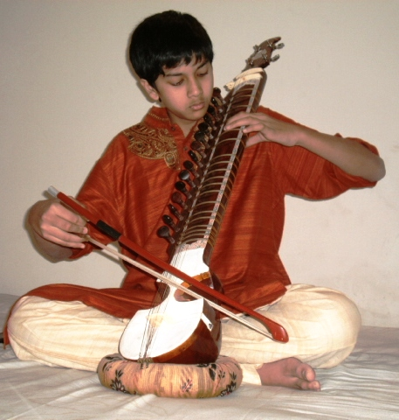
Within You, Without You, from Sgt. Pepper’s Lonely Hearts Club Band (1967)
Section | Description
0:00-0:23
0:24-1:12
1:13
1:16-1:57
1:58-2:23
2:24-3:27
3:28-3:41
3:42-4:33
4:34 to end
“Alap”
Performed on dilruba
“Gat”
Verse 1: Tala being used is tintal (16 beats); dilruba doubles the vocal line
Western string enter
Verse 2: Western strings – some are doubling vocal line in a simplified manner, others are droning
Start of chorus marked with a tabla flourish
Instrumental passage: tala switches to jhaptal (10 beats); Call and response throughout
Alap-like interlude
Verse 3
Chorus

Slide 25
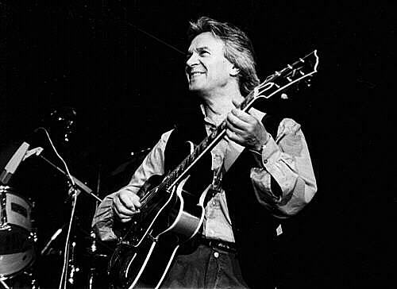
Contemporary Indian Music
Joy, performed by Shakti
Led by British jazz guitarist John McLaughlin
Musical influences include Western classical, Mississippi Delta blues, Spanish flamenco, jazz, rock
Worked with jazz great Miles Davis, 1969-1971
1971: formed Mahavishnu Orchestra, an influential jazz-rock fusion band that also showed strong Indian influences (tala-like rhythm cycles, raga-inspired scales)
During this time, McLaughlin began lessons with Ravi Shankar, studied yoga and began a process that eventually led to him converting to Hinduism.
All of this enabled McLaughlin to be immersed in the culture (unlike other Westerners), which transformed his music from a superficial to profound understanding of Indian musical art.
1975: formed Shakti (Indian-jazz fusion). Except for McLaughlin, all players were Indian classical musicians. This group featured members of both Hindustani and Karnatak traditions. Essentially Shakti was a fusion group within a fusion group

Slide 26
McLaughlin developed a special acoustic guitar that enabled him to approximate the microtonal pitches and timbral qualities of native Indian chordophones.
Section | Comments/Observations
A section 0:00—0:12
B section 0:13—0:26
Guitar/violin melody 0:27—0:39
Violin melody 0:40—1:02
1:03—1:38
A section 1:39—1:53
Tabla solo 1:54—2:05
Guitar solo 2:06—end
Melody played twice; “asymmetrical” rhythm of melody juxtaposed to symmetrical, 16-beat metric cycle underpinning
Similar to A but rhythmic manipulations are different
Violin takes over as lead melody instrument; raga-like ornamentations
Growing intensity; perpetual motion in guitar and violin parts
Beginning of long improvised guitar solo; fades out

Slide 27
Trilok Gurtu
Born in Mumbai in 1951. Mother was famous classical Indian vocalist, grandfather was a concert sitarist and musicologist, brothers were percussionists.
Influenced by, and interested in, Western music as much as classical Indian music.
Was a studio musician for Indian film music and toured/recorded with bhangra bands
1976: after several years of touring with Indian pop bands, Gurtu moved to New York and played drumset and percussion with American jazz artists.
After being rejected for admission to Berklee College of Music, Gurtu set out to create his own musical path. He invented a “floor kit” that featured instruments from multiple cultures.
Tapping upon his vast and varied musical experience, Gurtu created a genre-defying style.

Slide 28
Living Magic, from Living Magic (1991)
Section | Comments/Observations
“Alap” section 0:00—1:08
Transitional section bridging “Alap” and “Gat” sections 1:09—2:10
“Gat” section 2:11—end
Introduction of fundamental pitches (F & C)
Alap-like development follows
Electro-acoustic multitoned drone (electronically processed) begins to emerge and grow (0:13)
Progressive growth occurs as “alap” develops. Drone thickens and intensifies. The timbre gradually transforms
Bass line plays highly complex tala-like cycle gradually emerges and takes on a distinct shape (1:09-1:30)
Continued dynamic growth as tala-like cycle is firmly established; piano flourishes and drumming add substance to texture
Synthesizer melody
More clearly metric bass and drum accompaniment
New tala-like cycle marks commencement of gat-like section.
Excerpt fades as song continues

Slide 29
Indian Music Exam
Use the textbook website as a resource – http://highered.mheducation.com/sites/0073526649/student_view0/index.html
My teacher page (Global Studies – Indian Music tab) address is: http://www.muhlsdk12.org/Page/4293
Listening Portion: Identify songs by title. Song titles will be included on the exam
In praise of Krishna (bhajan)
Ishq
Kudi Kudi
O… Saya
Jai Ho
Sarasamadana
Raga nat bhairav
India
Love You To
Within You Without You
Joy
Living magic
Short Answers
Description of the Raga concept
Comparison between Hindustani and Karnatak traditions
Tala
Alap and Gat
Multi Choice: This will cover the gamut of Indian music from theory to instruments to significant musicians

